Slide 1

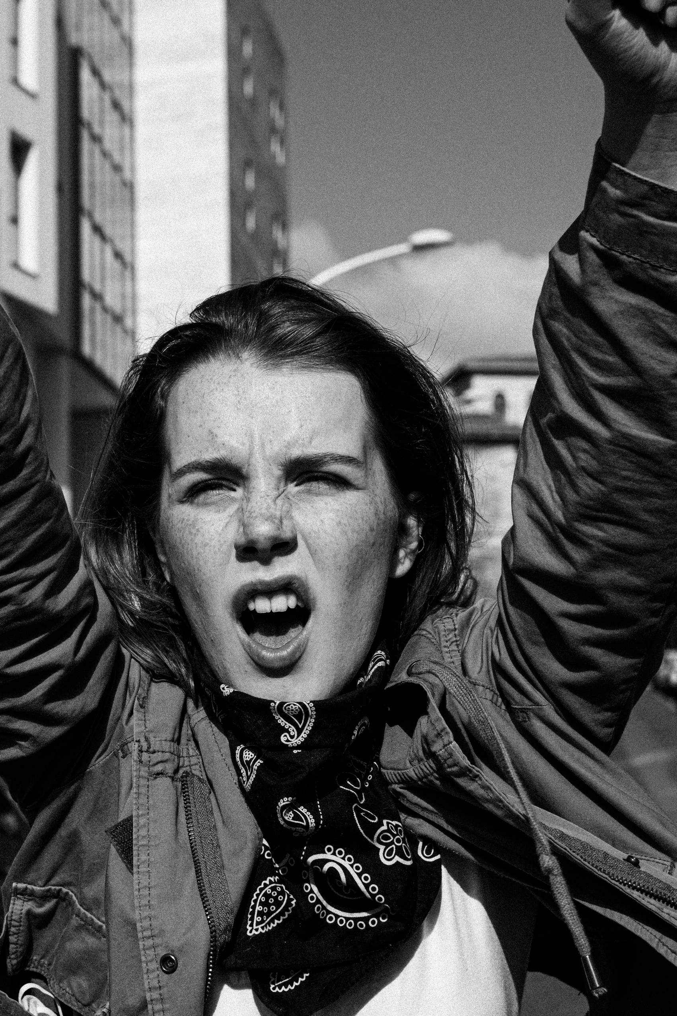

GENDER INEQUALITY
AND SOCIO-ECONOMIC FACTORS WORLDWIDE
PRESENTED BY : BHAVESH MEWARA

Slide 2

PROJECT OVERVIEW
"Exploring Global Gender Disparity: Analyzing Gender Inequality and Socioeconomic Factors Worldwide. Using Python's Pandas for data manipulation and Flourish for visualizations, this project investigates how gender inequality relates to key socioeconomic indicators across countries. It utilizes the Gender Inequality Index (GII) from the UNDP to examine disparities in health, education, and economic opportunities. The goal is to uncover insights into global gender gaps and their effects on human development, providing valuable perspectives to promote equality and progress."

Slide 3

STEPS
01
02
03
DATA PREPERATION
VISUALIZATION
PRESENTATION
Collect data from Kaggle. Then, utilize Pandas in Python for efficient data cleaning and manipulation
Importing data into flourish for visualization of key trends and patterns, and publishing to Canva
Craft a Canva presentation, adding
voiceover to elucidate visualizations
and highlight key insights for
clarity and engagement.

Slide 4
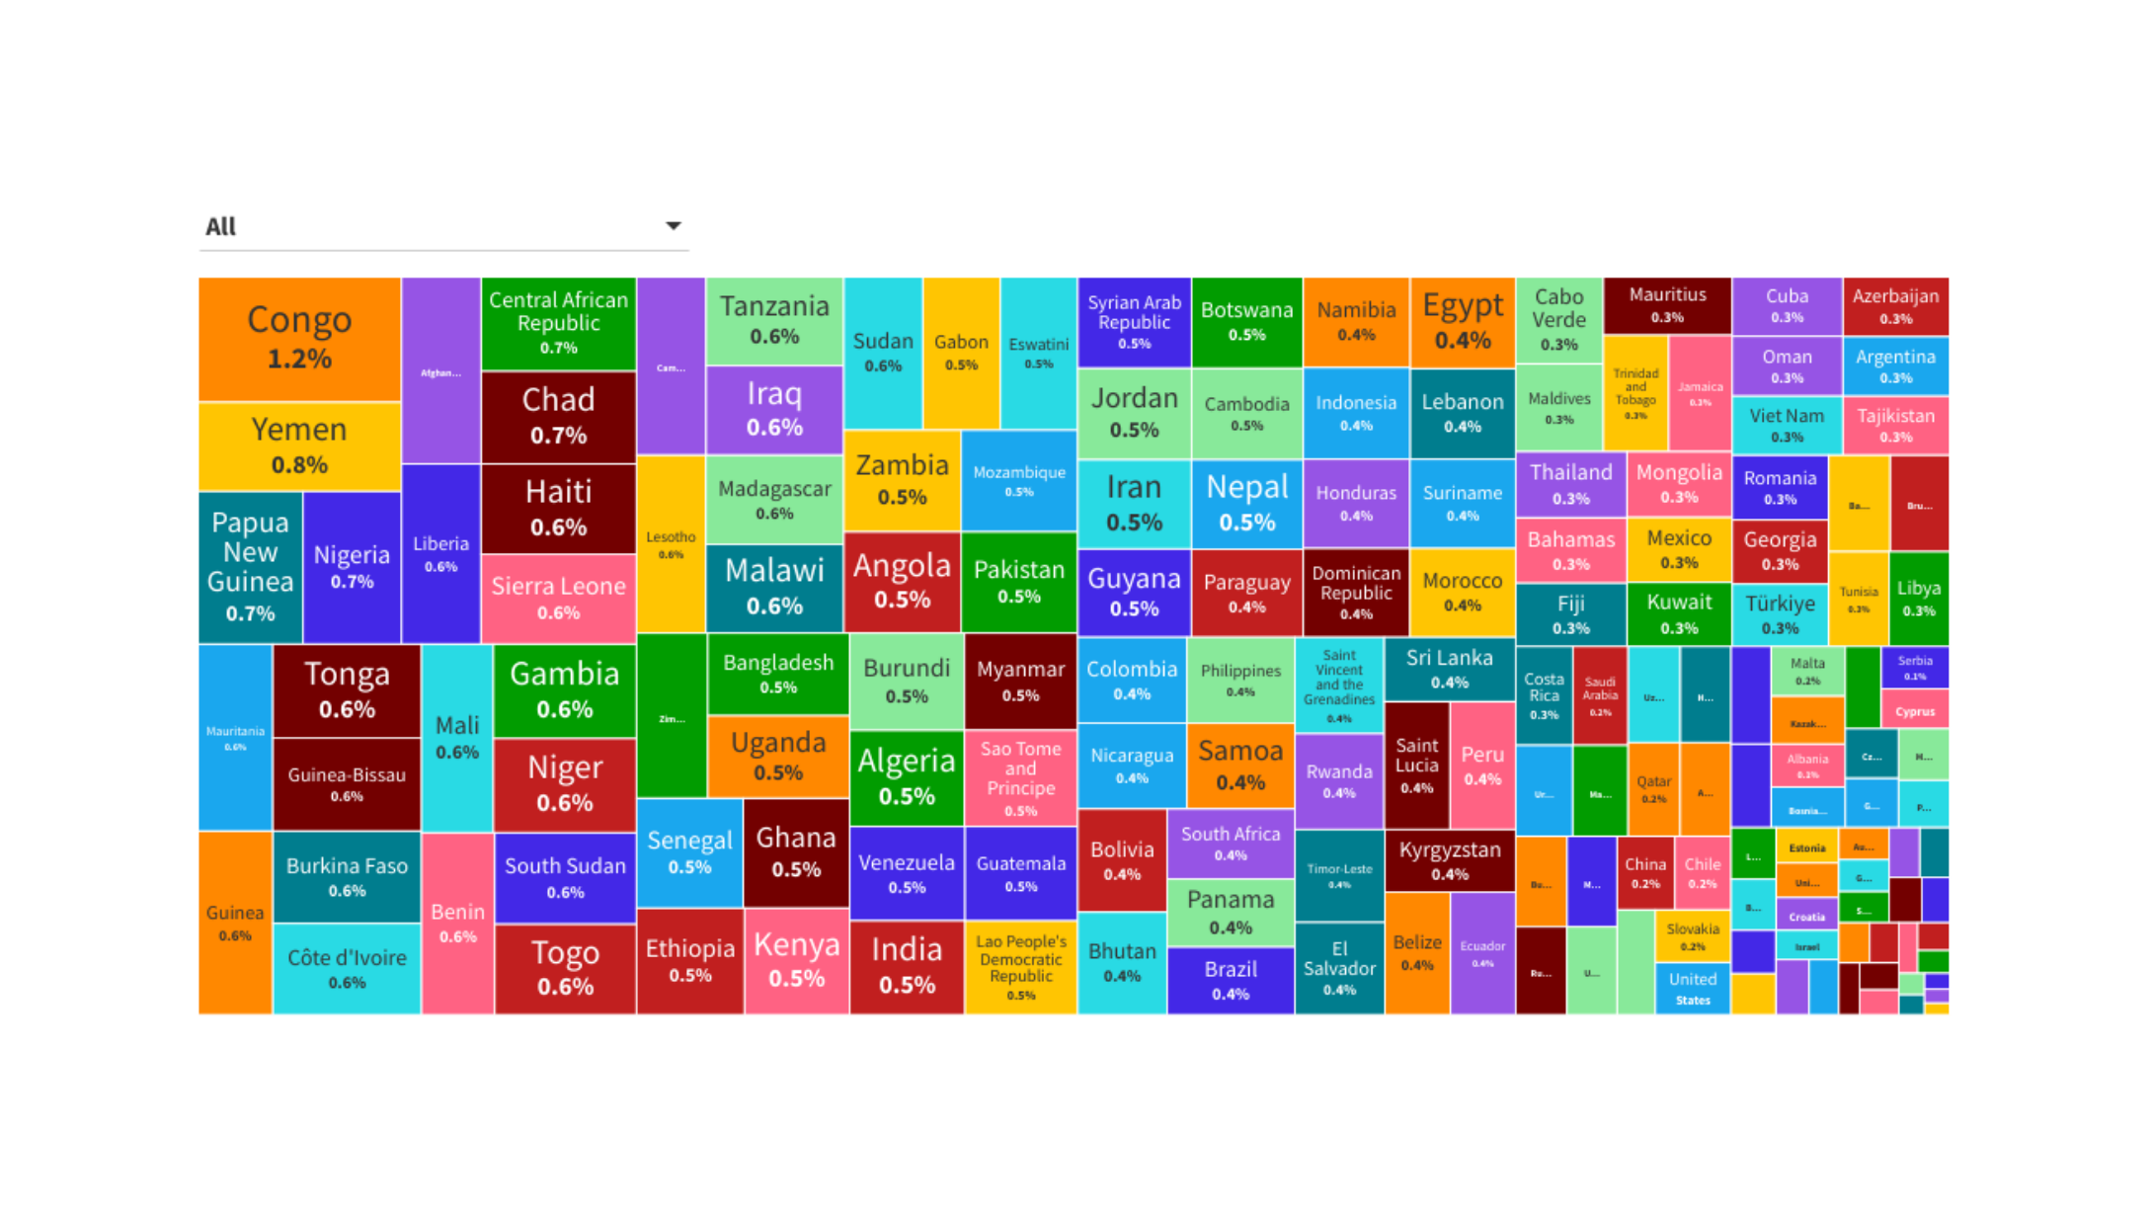
WORLD WIDE GENDER INEQUALITY

Slide 5
Different Socio-Economic Factors worldwide

Slide 6
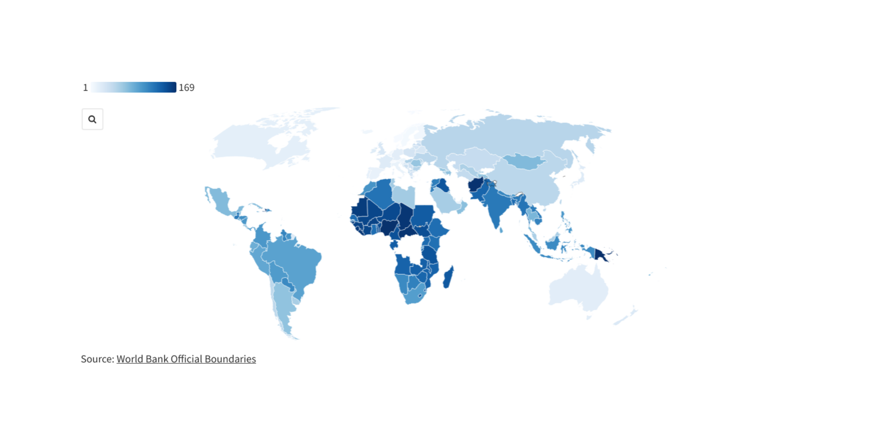
HUMAN DEVELOPMENT RANK WORLDWIDE
"Demark holds the highest worldwide rank in human development, while Yemen ranks lowest globally."

Slide 7
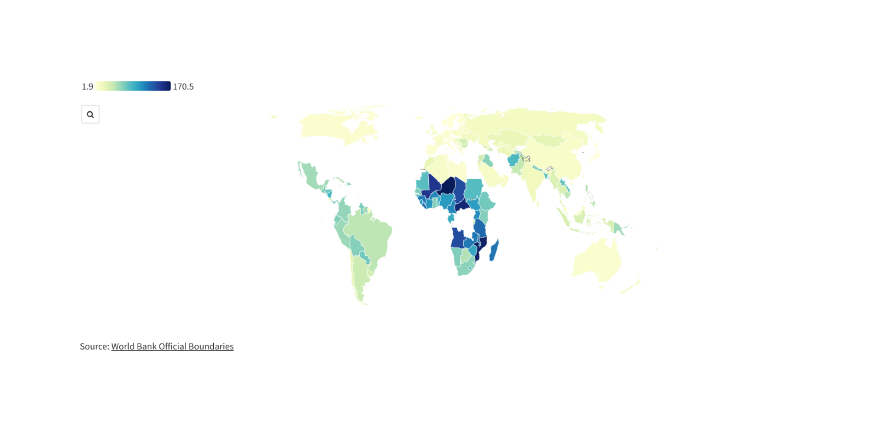
Adolescent Birth Rate Worldwide
"Demark boasts a low adolescent birth rate of 1.9 worldwide, whereas Niger faces a significantly higher rate of 170.5 worldwide."

Slide 8
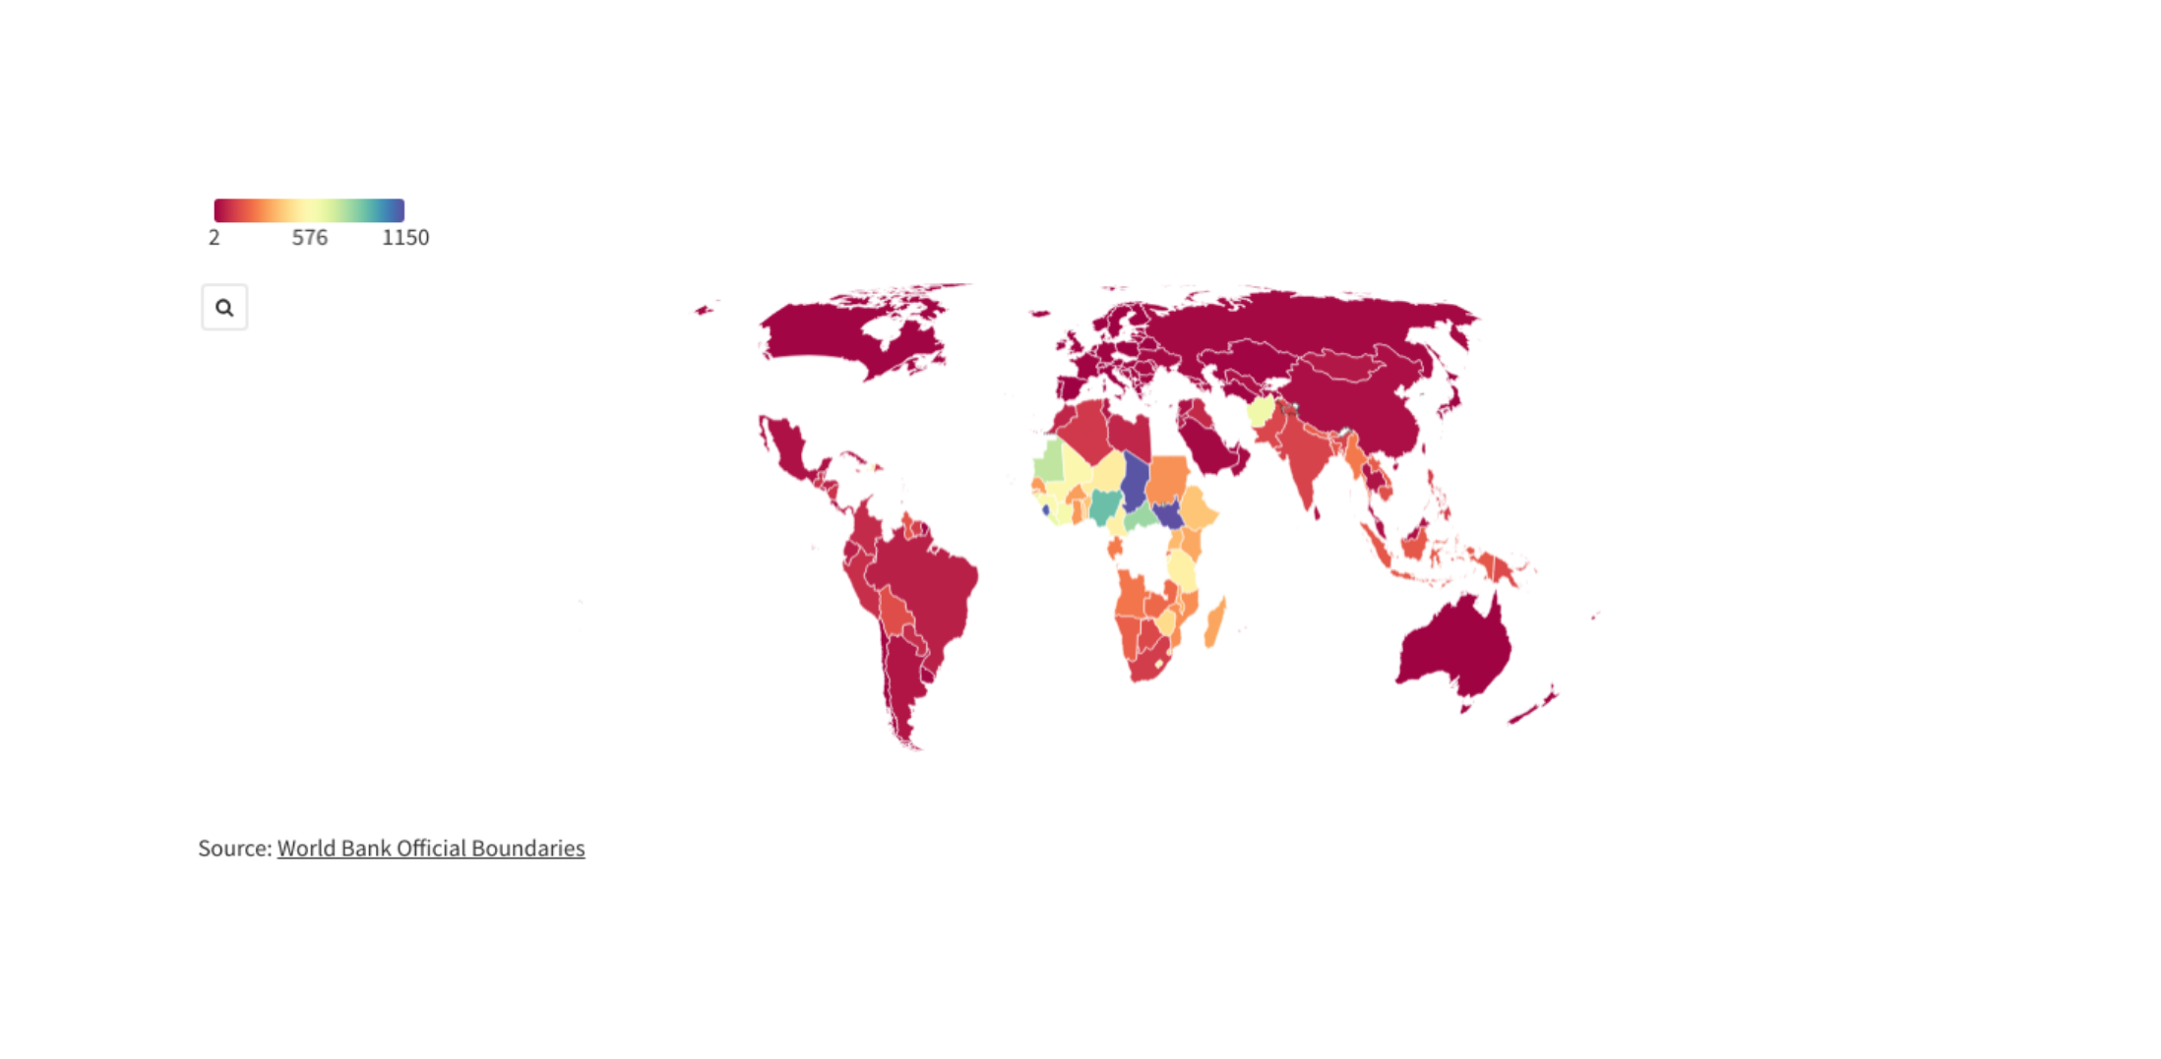
Maternal Mortality Rate Worldwide
"Norway, Italy, Poland, and Belarus have a maternal mortality rate of 2.0 worldwide, while South Sudan's rate is 1150, showing a stark difference."

Slide 9
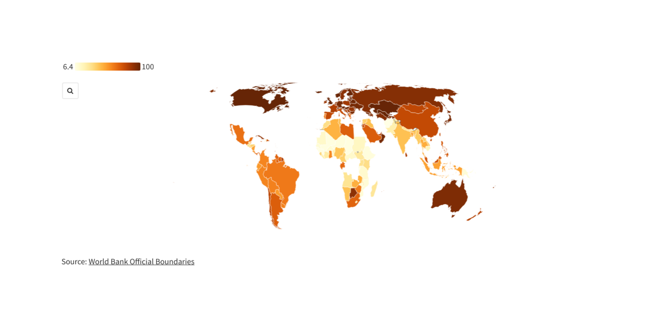
Female Secondary Education Worldwide
"Kyrgyzstan and Austria achieve a perfect score of 100 for female secondary education worldwide, whereas Afghanistan struggles with a rate of 6.4."

Slide 10
Relationship b/w Female Gender Inequality and Other Socioeconomic Factors

Slide 11
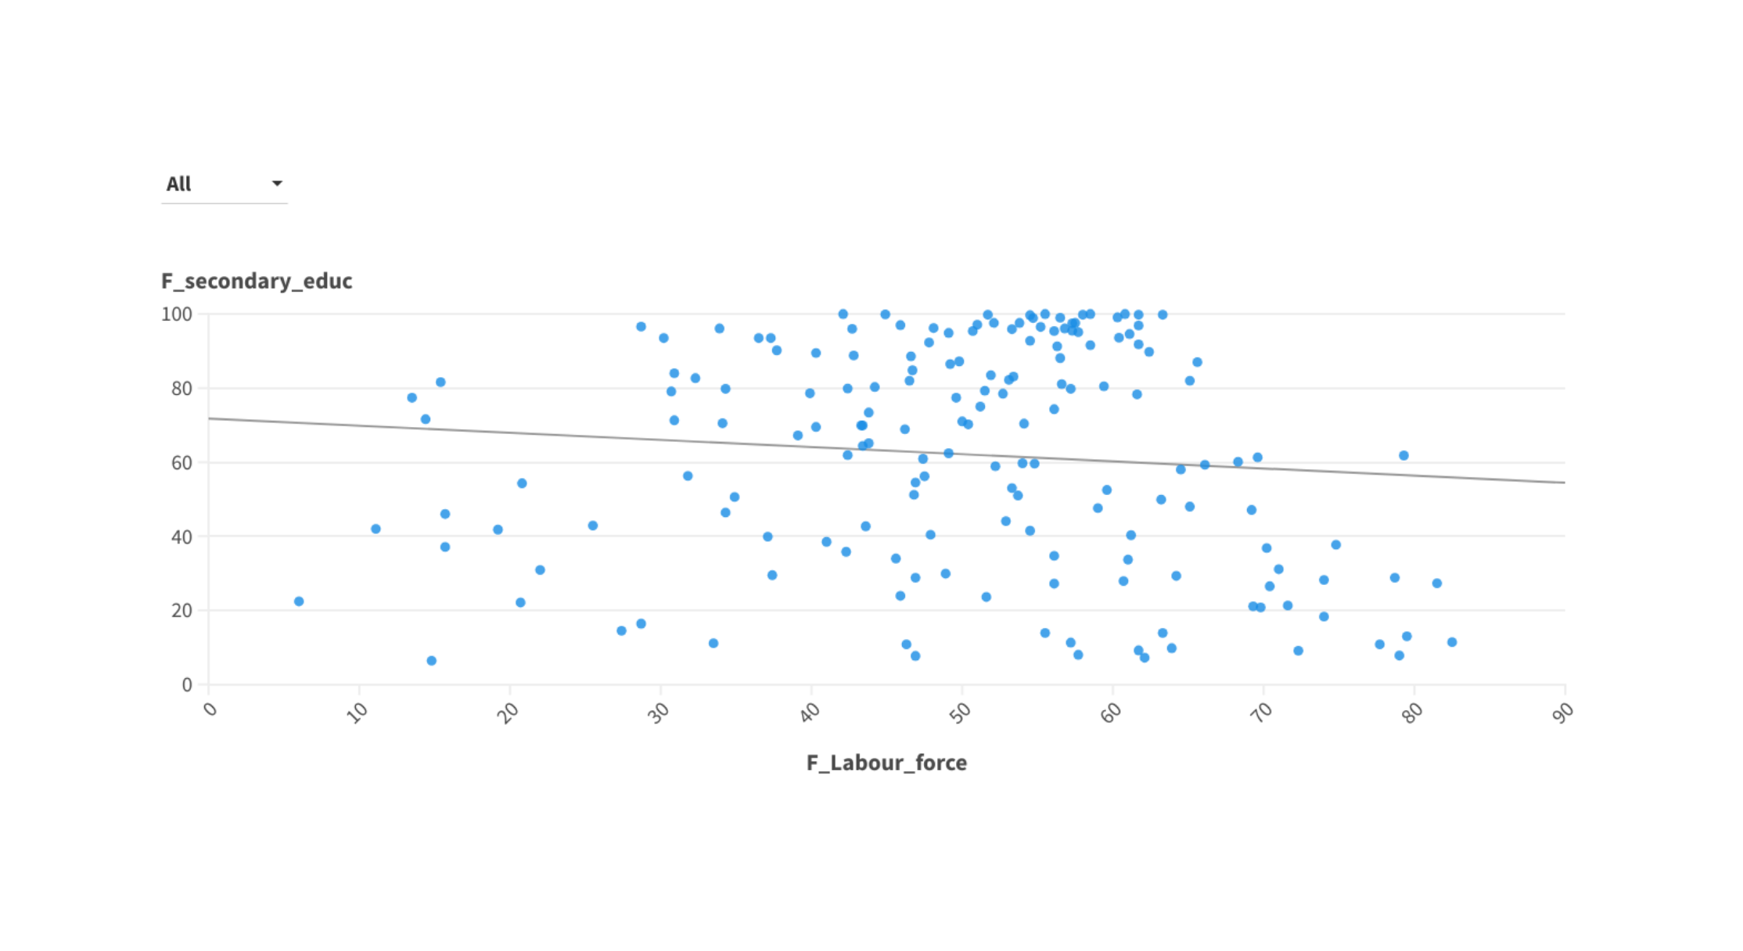
Education Female V/S Female Labour Force
Weak negative correlation observed between female secondary education and female labor force.
Increase in female labor force associated with a decrease in female secondary education

Slide 12
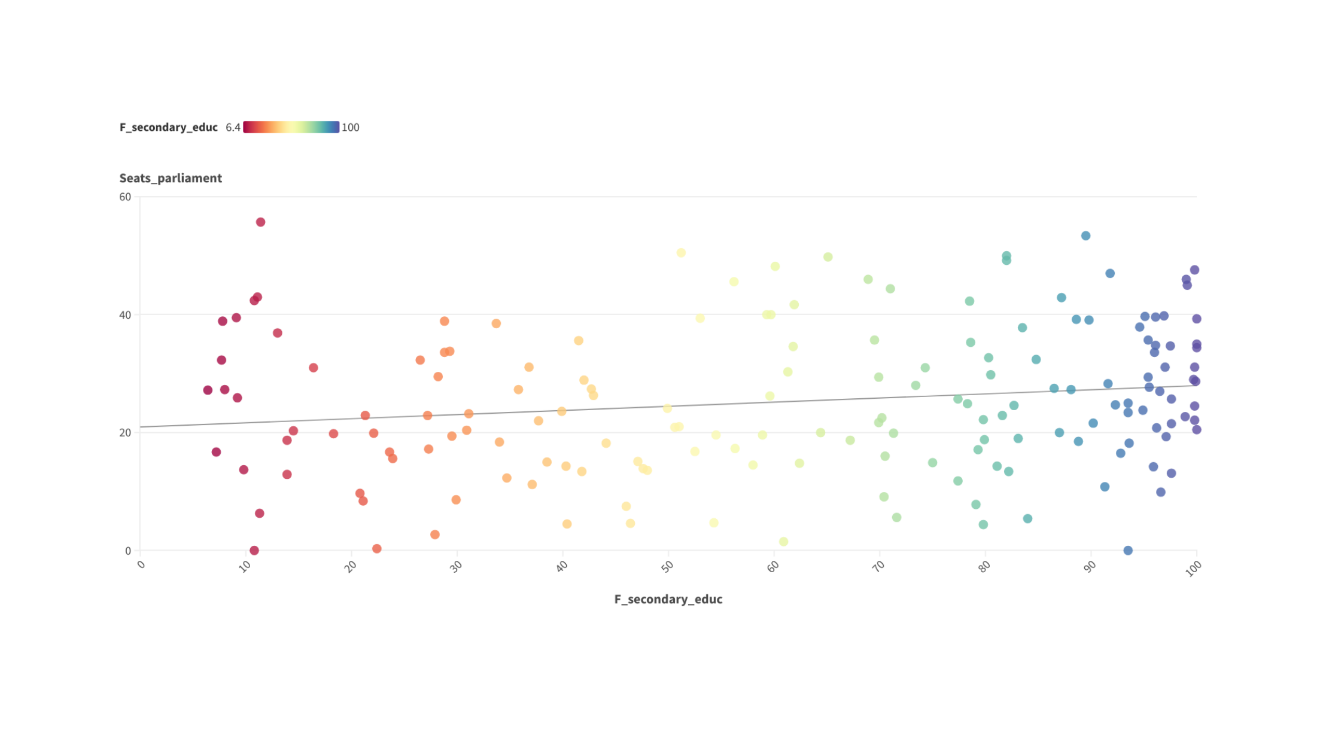
Education Female V/S Parliament Seat
Weak positive correlation observed between female secondary education and parliament seats.
Increment in female secondary education corresponds with a slight increase in the number of parliament seats held by women.

Slide 13
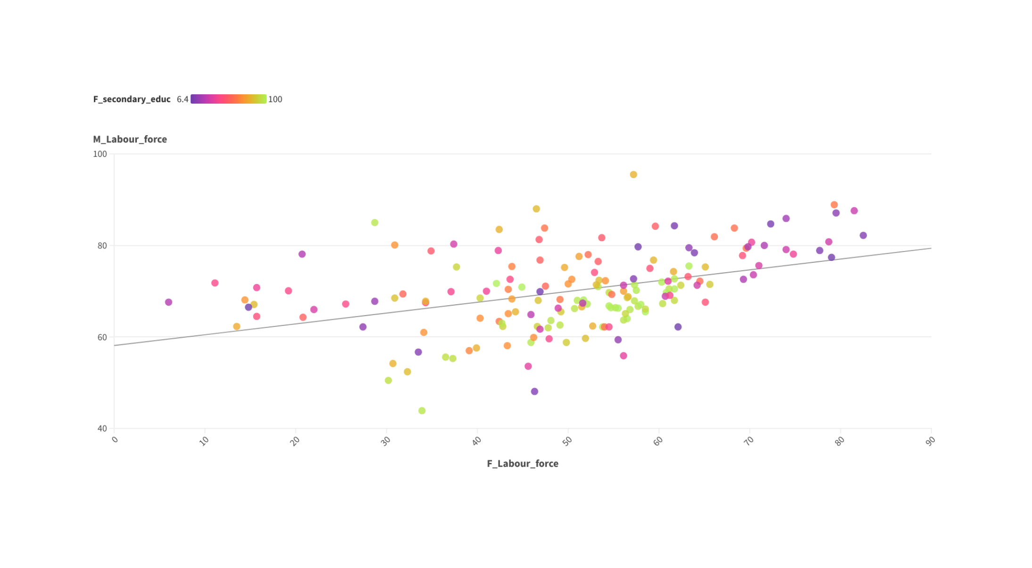
Female Labour Force V/S Male Labour Force
* There is positive releationship between female labour force and male labour force
No discernible pattern regarding inequality across the interaction of female and male labour force.

Slide 14
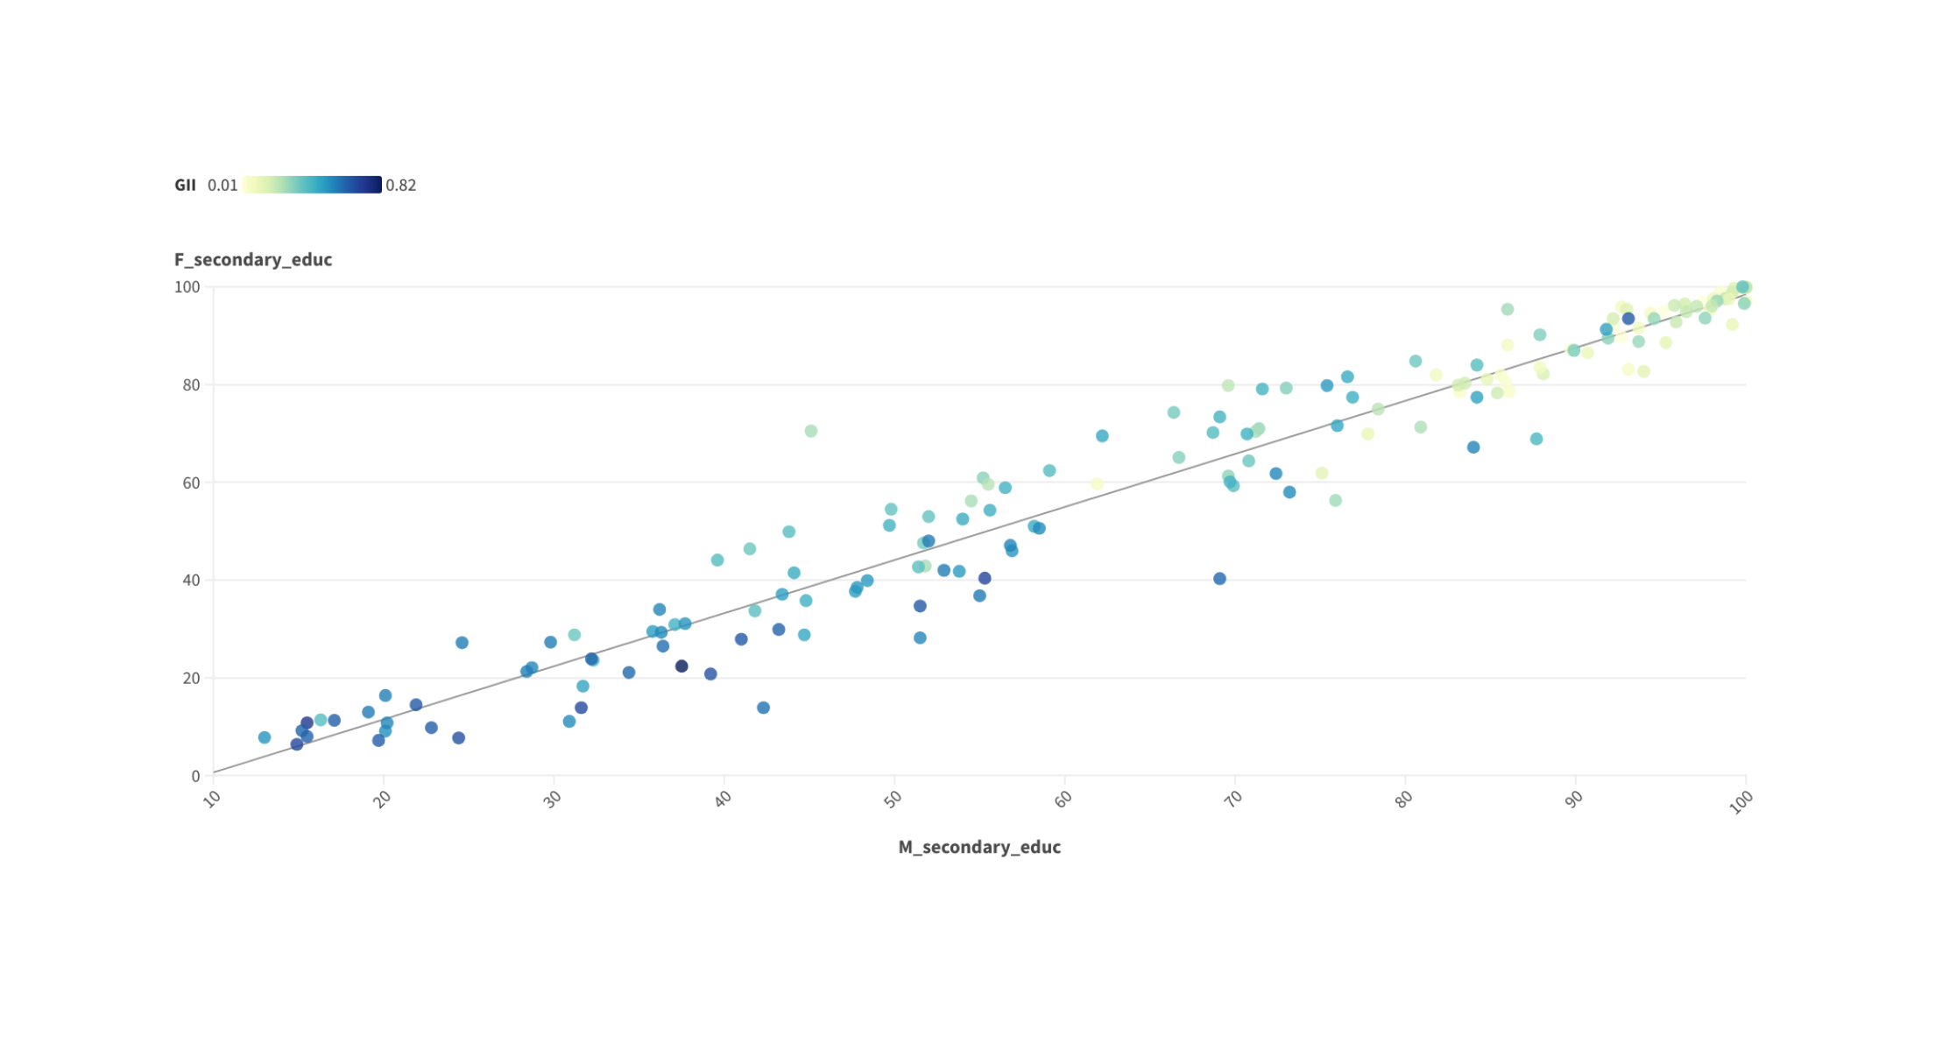
Educated Female V/S Educated Male
Positive relationship exists between female and male secondary education.
No discernible pattern regarding inequality across the interaction of female and male secondary education.

Slide 15
Human Development wise Analysis of All Socioeconomic Metrics

Slide 16
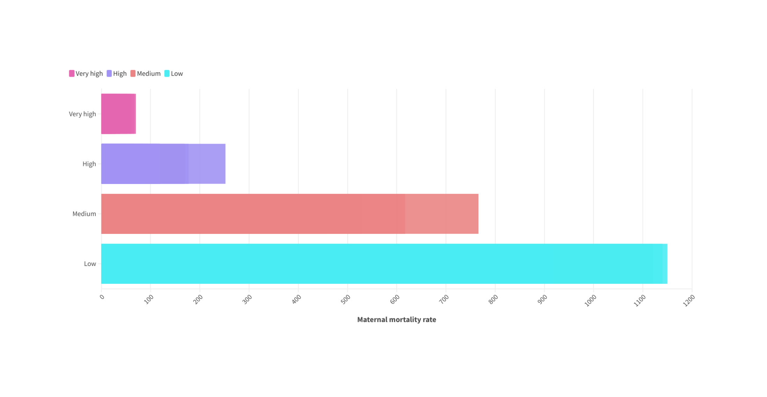
Maternal Mortality Rate By Human Development
Maternal mortality rate tends to increase as human development decreases.
Conversely, maternal mortality rate tends to decrease as human development increases, especially in areas with very high human development levels.

Slide 17
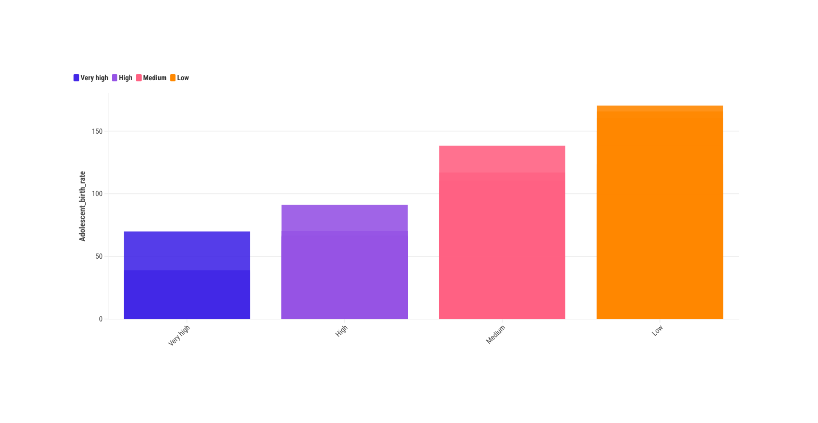
Adolescent Birth Rate By Human Development
Adolescent birth rate demonstrates an upward trend as human development declines.
Conversely, adolescent birth rate exhibits a downward trend as human development rises, especially in regions with very high human development levels.

Slide 18
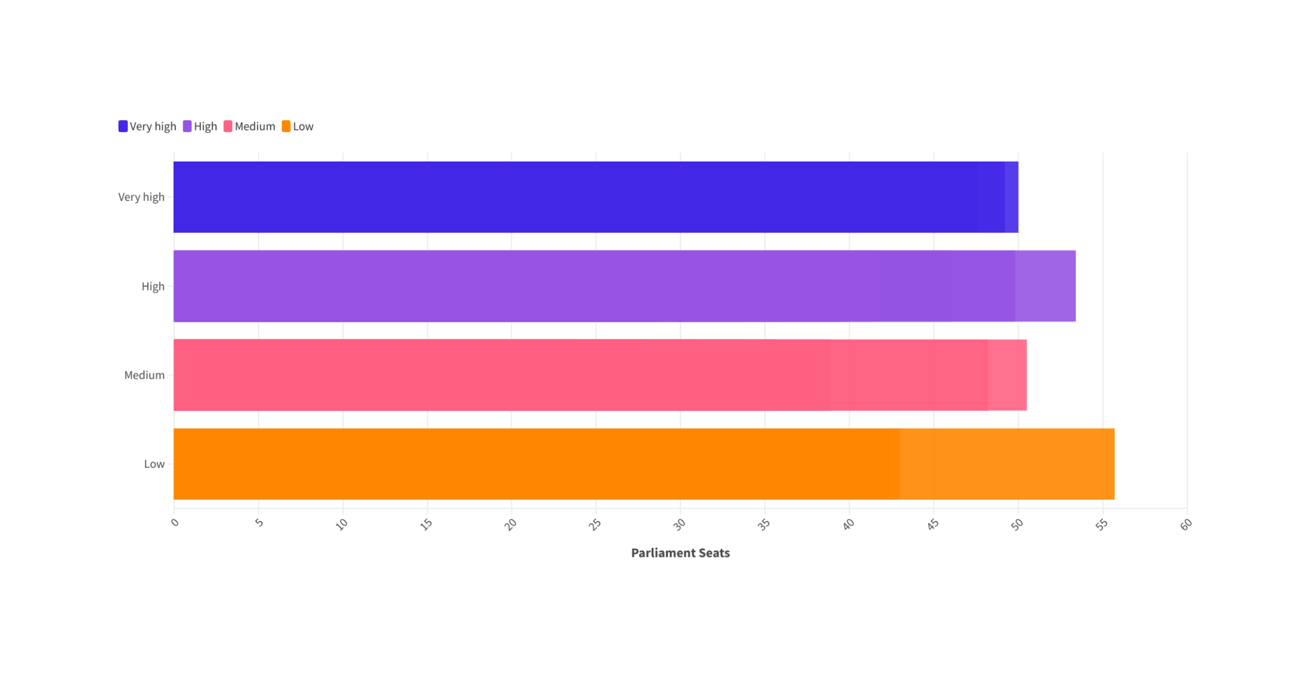
Parliament Seats By Human Development
Higher number of parliament seats tend to be observed in regions with lower human development.
Conversely, fewer parliament seats are typically found in regions with very high human development levels.

Slide 19
Key Inferences from the Data:
Countries with Good HDI:
Found in North America, Europe, North Asia Subcontinent, and Australia.
2. Factors Influencing Low HDI:
High Gender Inequality Index(GII)
3.GII itself is dependent majorly on the following factors
Female empowerment, including health and education.
Female labor force participation.
Political representation of women.
4. Female Empowerment and Health:
Influenced by factors such as adolescent birth rates and maternal mortality rates.
5. Impact of Education:
Higher female secondary education linked to decreased adolescent births and maternal mortality rates.
6. Female Labor Force and Political Representation:
Working women exist across educational backgrounds.
Political representation is enhanced with higher rates of female secondary education.

Slide 20




THANK YOU

